Slide 1
REDUX

Slide 2
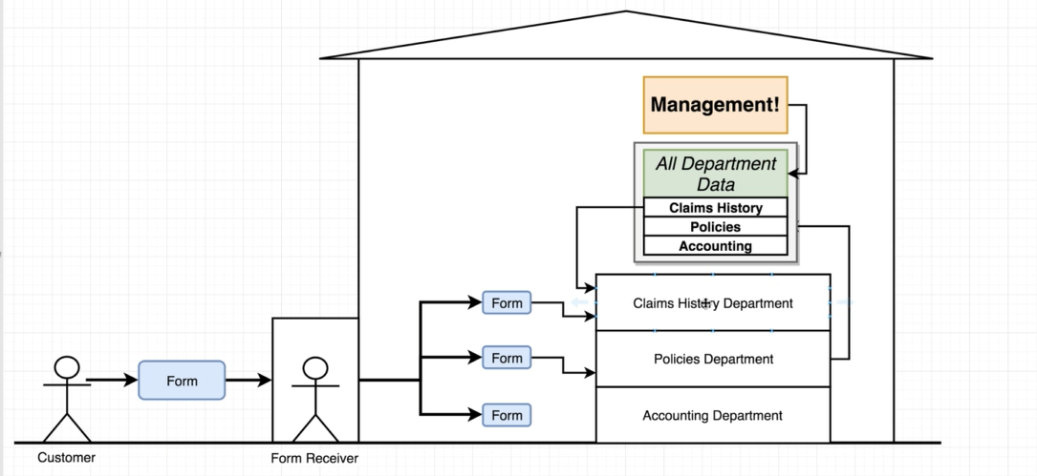
Redux

Slide 3

Actions

Slide 4
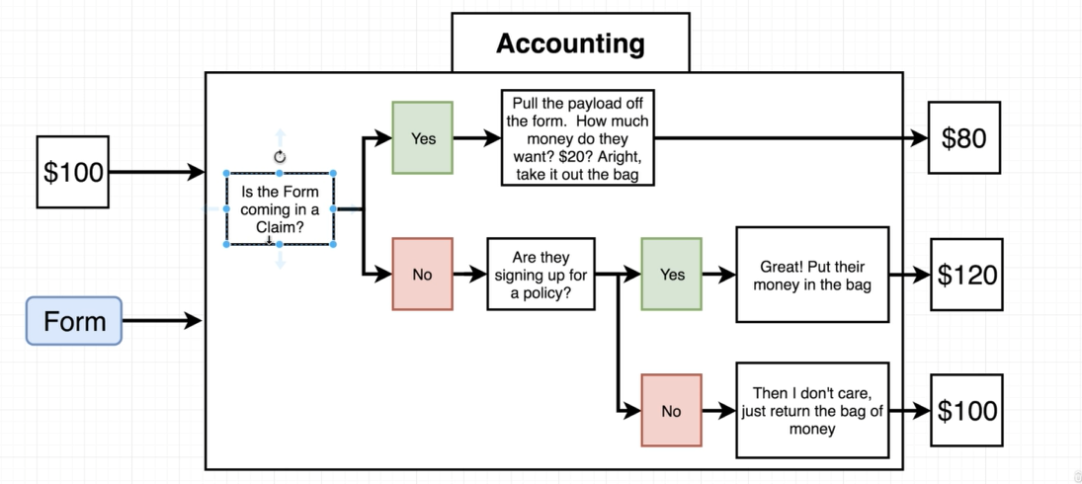
Accounting Reducer

Slide 5
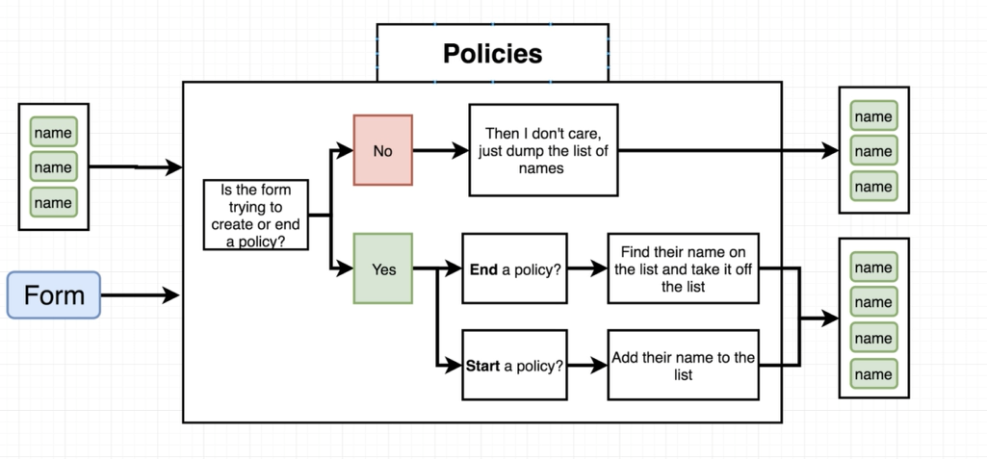
Policies Reducer

Slide 6
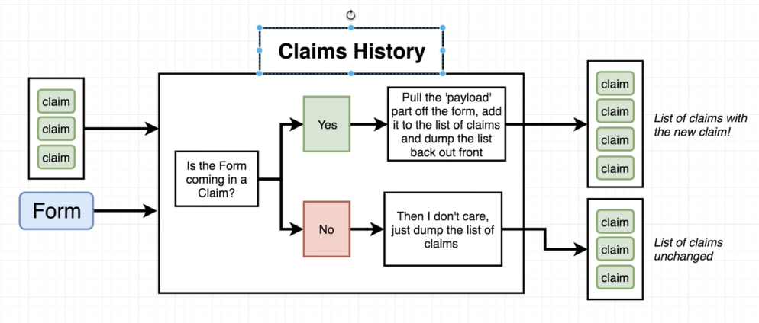
Claims Reducer

Slide 7
